Slide 1

Managing Innovation and Entrepreneurship at HEI – Good Practices for IP and Patenting Management

Slide 2
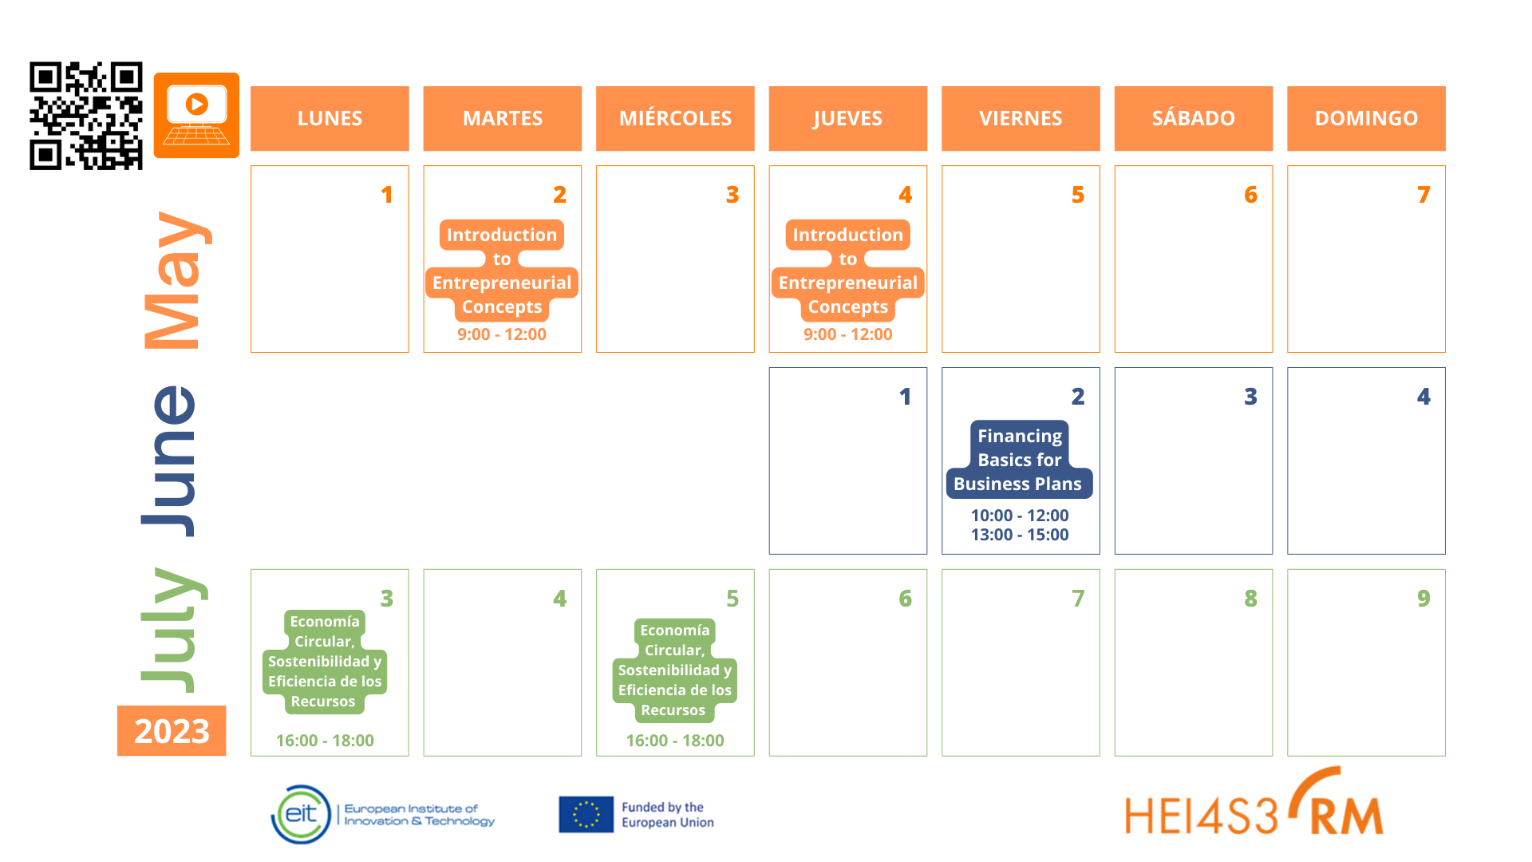
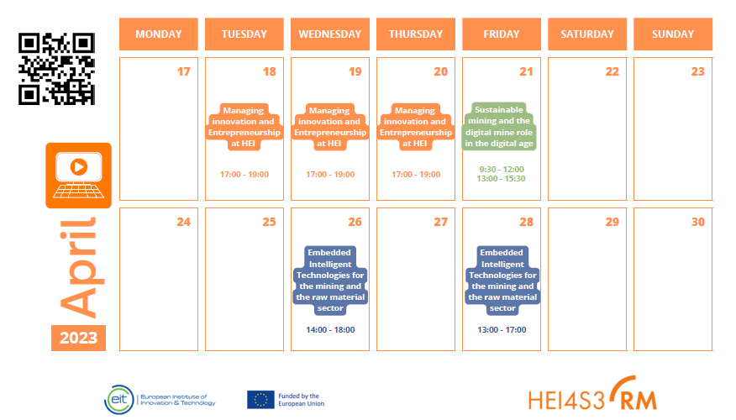
Welcome!
https://hei4s3-rm.eu/webinars/

Slide 3
Evaluation and Certificate
Questionnaire for the evaluation of the participants:
20th April at 20:00 (UTC +1).
Attendance: 3 days webinar 80%.
Certificate will be sent via e-mail by Lapland University of Applied Sciences.
Remember! Day 2 WEBINAR will be TOMORROW at 17:00 (UTC +3) EEST
For any enquiries, please contact me villalina@uniovi.es

Slide 4
Agenda
Day 1. 17.00h EEST-Entrepreneurial education In Finnish UAS: Policy and practices
Day 2. 17.00h EEST-Entrepreneurial education in Estonian HEIs: Policy and practices
Day 3. 17.00h EEST-Entrepreneurial education In Greece HEIs: Policy and practices.
At the end of the webinar, the Questionnaire will be carried out.

Slide 5
Guest Speaker-Day 1
Professor Anthony Okuogume: PhD and Masters in International Management, Postgraduate Certificate in International Business Strategy from the London school.
Prof. Okuogume has over 25 years of academic and consulting experience. He currently works as a Senior lecturer at the unit for digital solutions, LaplandUAS. Before that, has worked as a Principal Lecturer, Project Manager for CreaTolLab, dept of information processing Sciences, University of Oulu, Senior Researcher and Head of Degree Programmeat KajaaniUAS, Senior Business Analyst at KainuetuLtd. Also, held expert positions in several European ICT, SMEs and startups development projects and have worked as international startup consultant for FastercapitalInc. In addition, Prof. Okuogume is an innovation coach and has co-founded many companies. Teaching areas; Digital business Management, Customer experience Management, Digital economy, Business model innovation and Entrepreneurship.
Anthony Okuogume
Senior lecturer
Digital solutions | Lapland UAS

Slide 6
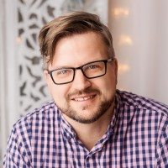
Guest Speaker-Day 2
PhD Power Engineering and Geotechnology Tallinn University of Technology. Senior Project Manager, Head of Division - Division of Mining and Mineral Technology - Department of Geology at Tallinn University of Technology (TalTech), Estonia. As a Senior Project Manager at TalTech for Horizon 2020, Horizon Europa and EIT Raw Materials, Dr. Karu and his team are open to solve the challenges in the raw materials sector. TalTech is a core member in EIT Raw Materials where are partnering in total 38 projects (since 2016). Also, TalTech is a core member of EIT Digital.
Veiko Karu
Senior Project Manager
Division of Mining and Mineral
Technology | TalTech

Slide 7
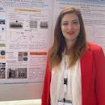
Guest Speaker-Day 3
Dr. Zoi S. Metaxa is an Assistant Professor at the Department of Chemistry of the International Hellenic University (IHU), Greece. She received her BS, MS and PhD in civil engineering from Democritus University of Thrace (DUTh), in 2005, 2007 and 2012, respectively. She has been a visiting pre-doctoral fellow at the Center for Advanced Cement-Based Materials (ACBM) at Northwestern University, directed by Professor S.P. Shah. Her expertise lies on the development of high performance advanced self-sensing cementitious nanocomposites. She is interested on investigating the correlation between the nanostructure and the mechanical performance of different composites and nanocomposites.
Zoi Metaxa
Assistant Professor
Department of Chemistry | International Hellenic University

Slide 8
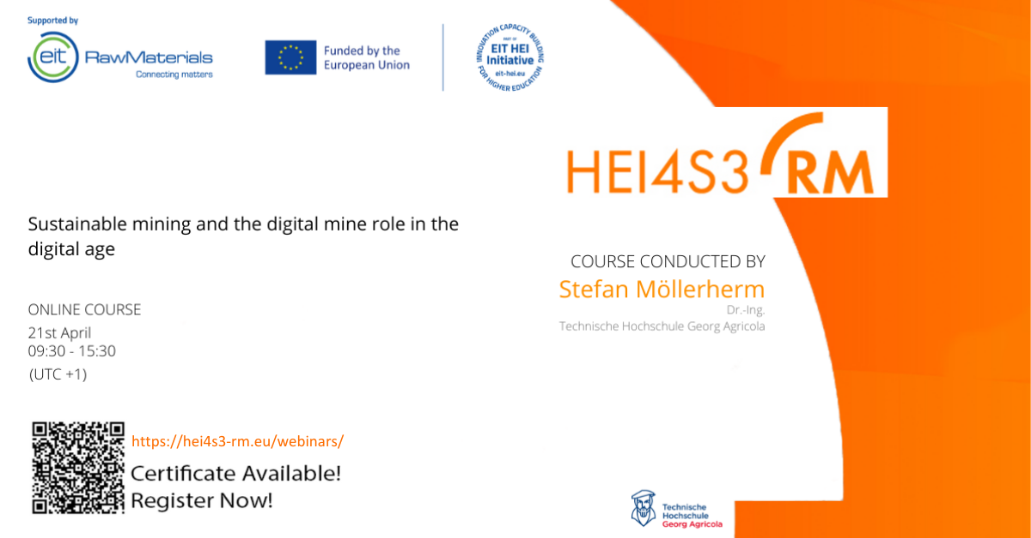
Join us!

